Slide 1
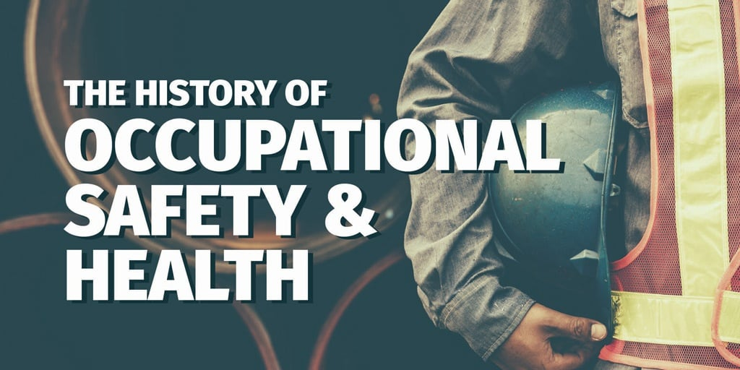
Lecture # 2
Prepared by:
Ms. Sadia Tariq

Slide 2
Background
In today’s safety-conscious world, it is hard to imagine a time when the wellbeing of employees wasn’t a priority. But, in the not-too-distant past, health and safety was a new concept.
In fact, it’s taken over 200 years to evolve to the laws and guidance we have today.
Nowadays, in many areas of the world, health and safety continues to improve year on year, with fatality and injury numbers gradually decreasing.
But health and safety wasn’t always a priority for businesses and legislators.
The health and safety legislation we see today has often been shaped by incidents that happened in the past.

Slide 3
Examples
In the UK, 28 fatalities at the Flixborough chemical plant in June 1974 was a catalyst for the formation of the Health and Safety Executive (HSE) and introduction of the Health and Safety at Work Act 1974.
In the US, one of the most notorious incidents was The Triangle Shirtwaist Company fire in 1911, which killed 146 employees when they could not escape through locked doors. In the 1960s, 14,000 US workers were dying each year. In addition, 2.2 million were out of work due to injuries and illnesses. To tackle this crisis, in December 1970, President Nixon signed the OSH Act, which became law on April 28, 1971.
In Canada, the Hogg’s Hollow disaster of March 1960, where five workers were killed by a fire and explosion whilst installing a water main, sparked a public outcry. This prompted the Ontario government to modernize safety regulations, leading to the enactment of the Industrial Safety Act in 1964.

Slide 4
Safety and Health at Work in Pakistan
One of the key areas of decent work deficit in Pakistan is poor occupational safety and health (OSH) at the workplace in both formal and informal sectors.
Most of the enterprises in the organized sectors are not aware of OSH risks and hazards, and often they do not see the importance and urgency of addressing those risks and hazards.
In 2012, a massive fire engulfed a factory in Baldia, Karachi, which killed more than 250 workers. Many key sectors of the economy namely construction, mining, agriculture and fishing face significant challenges in terms of OSH risks and hazards.
According to the ILO (International Labor Organization) reports, 2.2 million people die every year due to work-related accidents or illness, more than 270 million workers are injured and an estimated 160 million suffer work-related illness.

